Slide 1
Welcome To
Object Oriented Programing using C++
Lec-1
Dr. Saif Nalband

Slide 2

About Myself
90’s Kid From Mumbai
Completed my PhD BITS-Pilani, Goa Campus (YUP, I studied in GOA)
Taught at IIIT Pune
Went for Post-Doctoral Researcher at Cork, Ireland for a year.
Pandemic→DYPIU→IIIT Pune→TIET
Social Acitve on Linkdin, twitter
Hobbies ; Football, MUFC, binge watch some series, courses

Slide 3
About Course
Yet another (powerful/CP/fast) Programing Language
Object Oriented Programming
C++ (fast/speed)

Slide 4
Course Objective
To become familiar with object oriented programming concepts and be able to apply these concepts in solving diverse range of applications.

Slide 5
BuzzWord That you will be using
Class
Object
Inheritance
Instance
OOPS
encapsulation

Slide 6
Syllabus
Objects and Classes: Structure in C and C++, Class specification, Objects, Data hiding, Encapsulation and abstraction, namespaces, Array of objects, Passing objects as arguments, Returning object from a function, inline functions, Static data member and member function, ‘const’ member function.
Constructor and Destructor: Constructors, Parameterized Constructors, Constructor Overloading, Constructors in array of objects, Constructors with default arguments, Dynamic Initialization, Pointer to objects, this pointer, Dynamic memory allocation, Array of pointer to objects, Copy Constructor, Static objects, Friend function, and Friend classes.
Operator Overloading and Type Conversion: Syntax of operator overloading, Overloading Unary operator and Binary operator, Overloading arithmetic operator, relational operator, Overloading Unary operator and Binary operator using friend function, Data conversion, Overloading some special operators like ().

Slide 7
Inheritance: Derived Class declaration, Public, Private and Protected Inheritance, friend function and Inheritance, Overriding member function, Forms of inheritance, virtual base class, Abstract class, Constructor and Inheritance, Destructor and Inheritance, Advantage and disadvantage of Inheritance.
Polymorphism: Classification of Polymorphism, Compile time and Run time Polymorphism, Pointers to derived class object, Virtual functions, Pure virtual functions.
File handling: Formatted I/O, Hierarchy of file stream classes, Opening and closing a file, Working with multiple files, file modes, file pointers, Text vs. Binary Files.
Templates: Need of template, Function templates, Function template with non-type parameter, Overloading function templates, Class templates, Class template with non-type parameter.
Exception Handling: Exception handling mechanism, Multiple Catch Blocks, Catch All exceptions, Throw an exception, Exception Specification.
Standard Template Library: Fundamental idea about string, iterators, hashes and other types, The String and Vector classes vs. C-style pointers.

Slide 8
OutCome of Course
Introduces the need of analyzing algorithms and basic techniques used in the analysis
Makes students aware of standard design techniques
Makes students aware of complexity theory
Students equipped with all these topics will always be keen on writing efficient code, use standard techniques to solve problems from different domains and go for approximate solutions when the problems are computationally hard
This course would give them an edge over other software professionals who know only technology.

Slide 9
How to pass this course
Attendance is MUST!!!
DO NOT MUG THE PROGRAMS.
PRACTICE CODING .. It’s FUN.
[ placement -> packages -> || open source contribution

Slide 10
Resources to help
Text Books:
Schildt H., C++: The Complete Reference, Tata McGraw Hill (2003) 4th ed.
Lippman B. S., Lajoie J., and Moo E. B., C++ Primer, Addison-Wesley Professional (2013) 5th ed.
Reference books:
Lafore R., Object-Oriented Programming in C++, Pearson Education (2002) 4th ed.
E Balagurusamy, Object Oriented Programming with C++ (2017) 7th ed.
Stroustrup B., The C++ programming language, Pearson Education India (2013) 4th ed.
Online Resources :
Large number of tutorials, BUT only from good university...
HackerRank, CodeChef, Leetcode etc.

Slide 11
Classes
Monday, : 12:10 - 1:00 PM
Wednesday: 8:00- 08:50 AM
Thursday : 3:30 - 4:20 PM
Venue: LT102
Office Hours: 4:20-5:10 PM Thursday
Chamber no: CSED Building, 710.

Slide 12
I can be found on (Contact)
Preference on EMAILS:
Email: saif.nalband@thapar.edu
Mob: 9322317570
Avoid WhatsApp unless its emergency!!!
Chamber No: 710, CSED Building/activity Space 1

Slide 13
Online Class
Keeping the class interesting
Humor breaks
Actually helps with attention span!
Not surprisingly, most of it will be computer humor!

Slide 14
Let cook some code!!

Slide 15
Thinking in Objects
You can walk into a computer store and, with a little background and often some help, assemble an entire PC from various components: a motherboard, a CPU chip, a video card, a hard disk, a keyboard, and so on.
Ideally, when you finish assembling all the various self-contained units, you have a system in which all the units work together to create a larger system with which you can solve the problems you bought the computer for in the first place.

Slide 16
Internally, each of those components may be vastly complicated and engineered by different companies with different methods of design. But you don't need to know how the component works, what every chip on the board does, or how, when you press the ‘A’ key, an ‘A’ gets sent to your computer. As the assembler of the overall system, each component you use is a self-contained unit, and all you are interested in is how the units interact with each other.

Slide 17
Will this video card fit into the slots on the motherboard, and will this monitor work with this video card?
Will each particular component speak the right commands to the other components it interacts with so that each part of the computer is understood by every other part?
Once you know what the interactions are between the components and can match the interactions, putting together the overall system is easy.

Slide 18
What does this have to do with programming?
Everything.
Object-oriented programming works in exactly this same way. Using object-oriented programming, your overall program is made up of lots of different self-contained components (objects), each of which has a specific role in the program and all of which can talk to each other in predefined ways.

Slide 19
Problem Statement
Dominos made orders on behalf of registered customer. An order consists of a number of items. The order is either pending or serviced.
The following are the set of requirements regarding placed and serviced orders:
An order may be placed by registered customer.
A single customer may place a number of orders.

Slide 20
3. An order may be deleted or edited before being serviced.
4. An order must include at least one item (No null order).
5. The desired quantity of an placed item must not be null.
6. An order is serviced only after receiving payment from a customer.
7. The customer can pay by cash or by card.
8. An invoice is made at the time of servicing the order.

Slide 21
OOAD
The functionalities may be classified into 3 main subsystems:
Customer registration
Inventory management
Purchasing subsystem

Slide 22
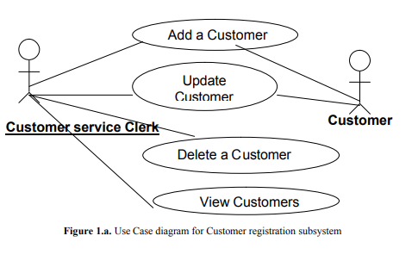
Use Case diagrams

Slide 23
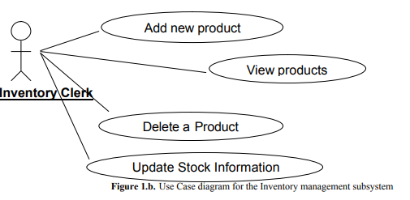

Slide 24
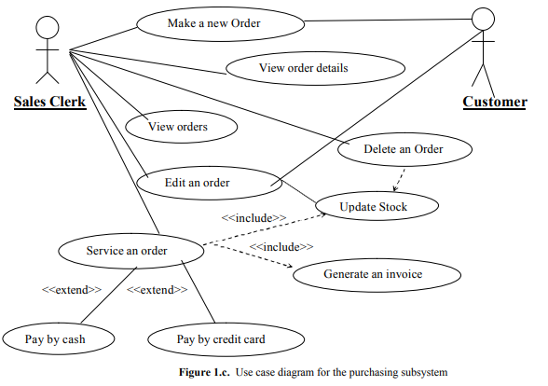

Slide 25
Class Diagrams
The class diagram is the most important entity in object oriented design.
It is very effective in showing what objects exists in the system and the static relationship between the classes.
It shows the relationships, roles and the navigability between the various existing entities.

Slide 26
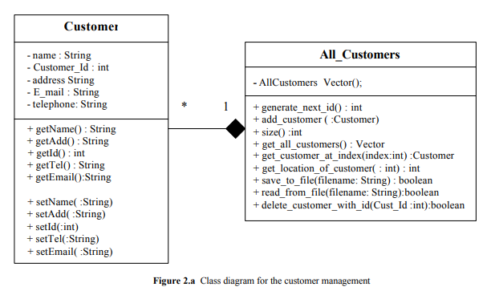

Slide 27
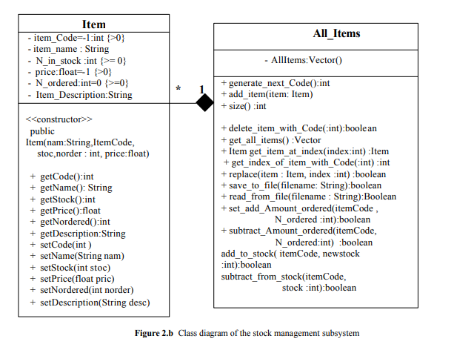

Slide 28
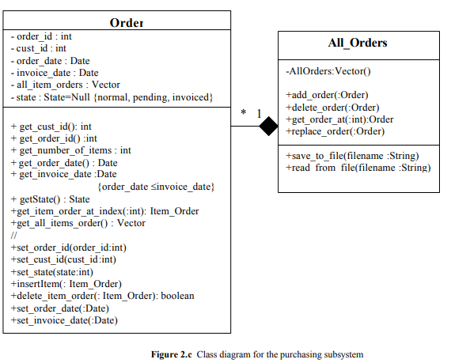

Slide 29
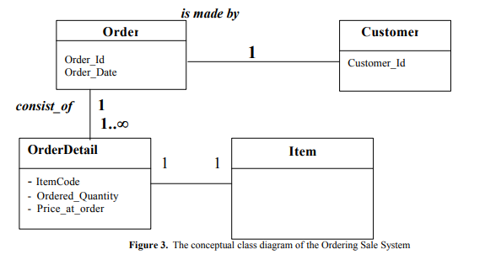

Slide 30
Contents
Basic Concepts of C++
Difference between C and C++
Applications of C++
How a program is Compiled?
Simple C++ Program

Slide 31
Basic Concepts of C++

Slide 32
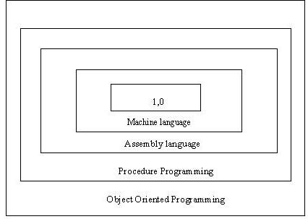
Basic Concepts of C++
Layers of Computer Software

Slide 33
C++ versus C language

Slide 34
Sr. | C language | C++
1 | Functions are basic elements | Classes are basic elements
2 | Focus on global functions | Focus on encapsulation (data+functions)
3 | Functions share global data | Data and function access is controlled
4 | Data moves openly | Data is bounded with classes
5 | Top down approach (break down into functions) | Bottom up (clubbing of data and functions together)

Slide 35
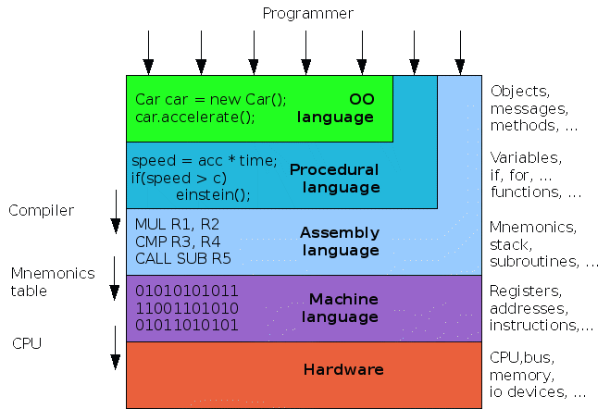
Basic Concepts of C++

Slide 36
Basic Concepts of C++
Object Oriented Programming is method of programming where a system is considered as a collection of objects that interact together to accomplish certain tasks. Objects are entities that encapsulate data and procedures that operate on the data.
In OOPS first a concept known as "Object Oriented Analysis (OOA)" is used to specify the objects in term of real world requirements, their behavior and interactions required. The next concept would be the "Object Oriented Design (OOD)" that converts these real-time requirements as a hierarchy of objects in terms of software development requirement. Finally OOPS is used to implement the requirements using the C++ programming language.
The main purpose of object oriented programming is to simplify the design, programming and most importantly debugging a program. So to modify a particular data, it is easy to identify which function to use. To add additional features it is easy to identify where to add functions and its related data.

Slide 37
Basic Concepts of C++
Object Oriented Programming Language
Basic Concepts:
Objects
Classes
Data Abstraction
Encapsulation
Inheritance
Polymorphism
Dynamic Binding
Message Passing

Slide 38
Objects
Basic runtime entity in an object – oriented system.
Often termed as “instance” of a class.
Example:
a person, a place, a bank account etc.
They can be of any type based on its declaration.
When program is executed, objects interact by sending messages at runtime.
Example 2:
Two objects namely, “customer”, “account”. Customer object may send a message to the account object requesting for bank balance.

Slide 39
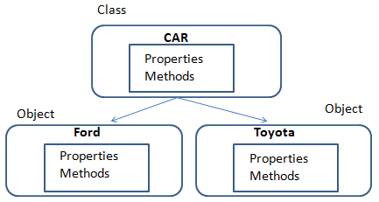
Classes
Class is a collection of objects of similar type.
Class is a way to bind the data and its associated functions together.
Objects are basically variable of the class or an object is an instance of a class.
Examples:
Shape is a class and Rectangle, Square, Triangle are its objects.

Slide 40
Four features of object oriented programming
Encapsulation
Abstraction
Inheritance
Polymorphism

Slide 42
Encapsulation

Slide 43
Abstraction

Slide 44
Inheritance

Slide 45
Polymorphism – late binding flexibility

Slide 46
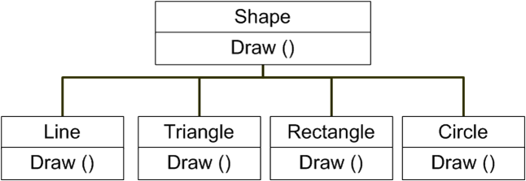
Polymorphism
C++ polymorphism means that a call to a member function will cause a different function to be executed depending on the type of object that invokes the function.

Slide 47
Dynamic Binding
Binding refers to the linking of a procedure call to the code to be executed in response to the call.
Dynamic binding (late binding) means that the code associated with a given procedure call is not known until the time of the call at run-time.
Associated with polymorphism and inheritance.

Slide 48
Message Passing
OOPs consists of a set of objects that communicate with each other.
This involves following steps:
Creating classes that define objects and their behavior
Creating objects from class definitions.
Establishing communication among objects
A message for an object is a request for execution of a procedure, and therefore will invoke a function (procedure) in the receiving object that generates the desired result.

Slide 49
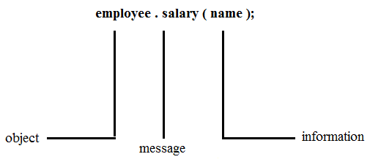
Message Passing
Message passing involves specifying the name of the object, the name of the function (message) and the information to be sent.

Slide 50
Difference between C and C++

Slide 51
Difference between C and C++
S. No. | Procedural Programming (C) | Object Oriented Programming (C++)
1 | Emphasis is on doing things (algorithms). | Emphasis is on data rather than procedure.
2 | Large programs are divided into smaller programs in the form of functions. | Programs are divided into objects. Functions that operate together are tied together in the data structure.
3 | Most of the functions share global data. | Data is mostly hidden and cannot be accessed by external functions.
4 | Data move openly around the system from function to function. Functions transform data from one form to another. | Objects may communicate with each other through functions. New data and functions can be easily added wherever necessary.
5 | Employs top-down approach in program design. | Follow bottom-up approach in program design.

Slide 52
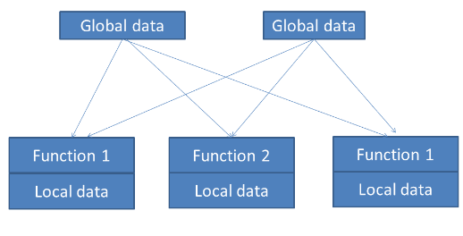
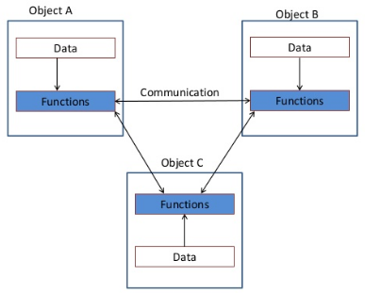
Difference between C and C++
Functioning of Procedural Language
Functioning of Object Oriented Programming Language

Slide 53
Difference between C and C++
A class is an extension of the idea of structure used in C.
A new way of creating and implementing user-defined data type.

Slide 54
C Structures
Provide a method for packing together data of different types.
A convenient tool for handling a group of logically related data items.
Eg:
struct student
{
char name[20];
int roll_no;
float total_marks;
} A;

Slide 55
Limitations
Cannot treat struct data-type like built in data type.
Example:
struct Complex
{
float x;
float y;
} c1, c2,c3;
Complex nos. c1, c2, c3 can be easily assigned values using dot operator, but we can’t directly add or subtract two complex nos. i.e.
c3 = c1 + c2; // illegal in C.
Do not permit data hiding. Structure members are public members.

Slide 56
C++ Classes
Attempts to bring user defined types as close as possible to the built-in data types.
Also provides facility to hide the data.
Inheritance is also supported by C++

Slide 57
Applications

Slide 58
Applications of OOPs Languages
Real-time systems
Simulation and Modeling
Object-oriented Databases
Hypertext and Hypermedia systems
AI and expert systems
Neural Networks and parallel programming
Decision Support and office automation systems
CIM/CAM/CAD systems

Slide 59
How a Program is Executed?

Slide 60
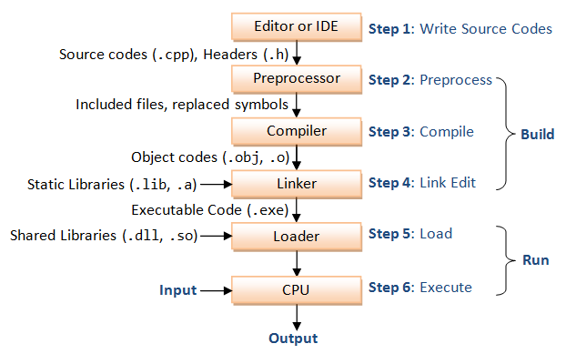
Flowchart

Slide 61
1. Editor
C++ program is written in an Editor.
Saved as a file with extension .cpp.

Slide 62
2. Preprocessor
Preprocessing performs (usually simple) operations on the source file(s) prior to compilation.
Typical preprocessing operations include:
(a) Expanding macros (shorthand notations for longer constructs). For example, in C,
#define abc(x,y) (3*x+y*(2+x))
In program n = abc(a,b) becomes
n = (3*a+b*(2+a))
(b) Inserting named ﬁles. For example, in C++,
# include <iostream>
is replaced by the contents of the ﬁle iostream.h

Slide 63
3. Compiler
Compiler is a program that can read a program in one language — the source language — and translate it into an equivalent program in another language — the target language or machine language.
An important role of the compiler is to report any errors in the source program that it detects during the translation process.

Slide 64
4. Linker
A linker combines object code (machine code that has not yet been linked) produced from compiling and assembling many source programs, as well as standard library functions and resources supplied by the operating system.

Slide 65
5. Loader
Compilers, assemblers and linkers usually produce code whose memory references are made relative to an undetermined starting location that can be anywhere in memory.
(relocatable machine code)
The loader then puts together all of the executable object files into memory for execution.
A loader calculates appropriate absolute addresses for these memory locations and amends the code to use these addresses.

Slide 66
6. Execute
CPU executes the program one instruction at time.

Slide 67
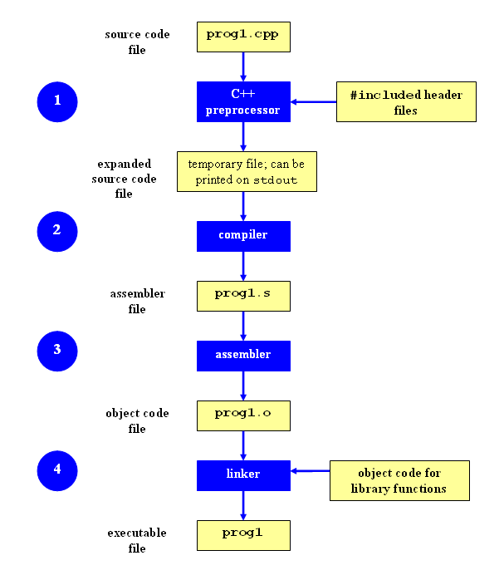
A Bit more about execution
1. To stop the process after the preprocessor step, you can use the -E option:
g++ -E prog1.cpp
The expanded source code file will be printed on standard output (the screen by default).

Slide 68
2. To stop the process after the compile step, you can use the -S option:
g++ -S prog1.cpp
By default, the assembler code for a source file named filename.cpp will be placed in a file named filename.s.

Slide 69
3. To stop the process after the assembly step, you can use -c option:
g++ -c prog1.cpp
By default, the assembler code for a source file named filename.cpp will be placed in a file named filename.o.

Slide 70
A simple C++ Program

Slide 71
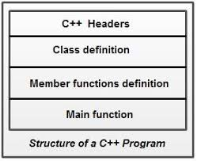
General Structure of C++ Program

Slide 72
“Hello World” in C++
Use the standard namespace
Include standard iostream classes
using namespace std;
#include <iostream>
// My first C++ program!
int main(void)
{
cout << "hello world!" << endl;
return 0;
}
A C++ comment
cout is an instance of iostream
operator overloading
(two different argument types!)

Slide 73
Thank you

